Slide 1
The Attributes of God

Slide 2
1. They must know WHO I AM…tell them 2. They must know WHO they are…assure them 3. They must know WHO he is (satan)…expose him

Slide 3
God is Almighty
And we abide
In His
shadow
(2X)
Tune: Are you sleeping.

Slide 4
He who dwells in the
secret place of the
Most High shall abide
under the shadow
of the Almighty.
Psalms 91 verse 1 (3x)
Finish with: My God is Almighty!
Tune: Nothing but the Blood of Jesus

Slide 5
God is The Alpha
And The Omega
He is The First
And He is The Last.
(2X)
Tune: Are you sleeping.

Slide 6
“I am The Alpha
and The Omega,
The Beginning,
and The End,”
Says the Lord….
Revelation 1 verse 8a
(2X)
Tune: Are you sleeping.

Slide 7
God is Beautiful
and He makes all
things beautiful.
Tune: Are you sleeping.

Slide 8
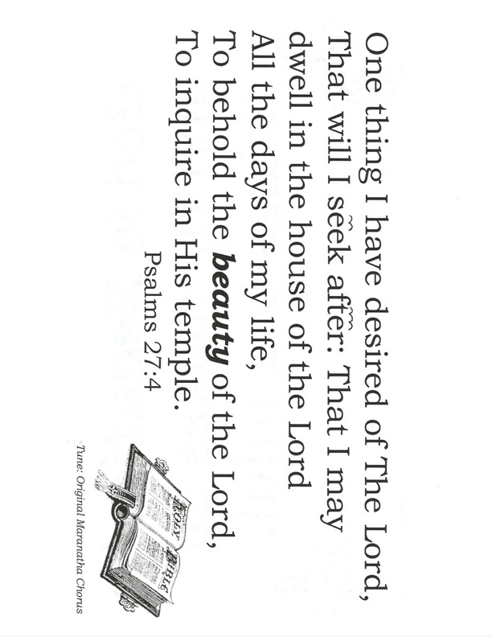
One thing I have desired of The Lord,
That will I seek after: That I may dwell in the house of the Lord
All the days of my life,
To behold the beauty of the Lord,
To inquire in His temple.
Psalms 27:4
Tune: Original Maranatha Chorus

Slide 9
God is my Counselor
He will guide me
(2X)
Tune: Are you sleeping.

Slide 10
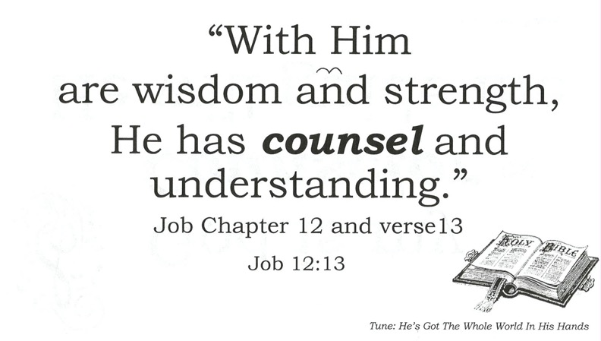
“With Him
are wisdom and strength,
He has counsel and understanding.”
Job Chapter 12 and verse13
Job 12:13
Tune: He’s Got The Whole World In His Hands

Slide 11
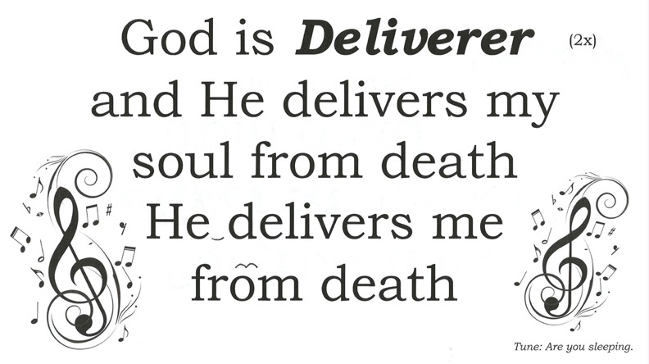
God is Deliverer
and He delivers my
soul from death
He delivers me
from death
(2x)
Tune: Are you sleeping.

Slide 12
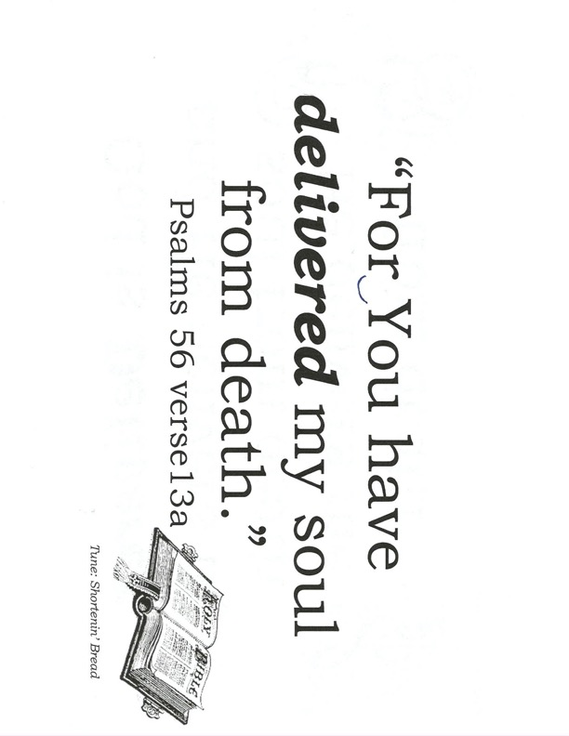
“For You have
delivered my soul
from death.”
Psalms 56 verse13a
Tune: Shortenin’ Bread

Slide 13
God is Eternal
He had no
beginning
God is Eternal
and
He will never end
(2x)
(2x)
Tune: Are you sleeping.

Slide 14
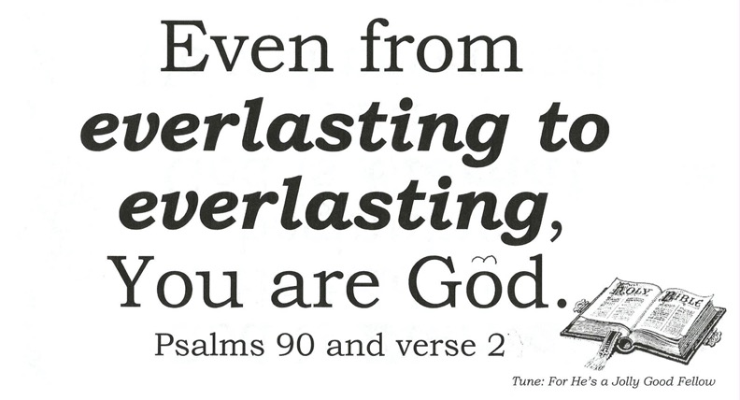
Even from
everlasting to
everlasting,
You are God.
Psalms 90 and verse 2b
Tune: For He’s a Jolly Good Fellow

Slide 15
God is Faithful
He always keeps
His word.
(2x)
Tune: Are you sleeping.

Slide 16
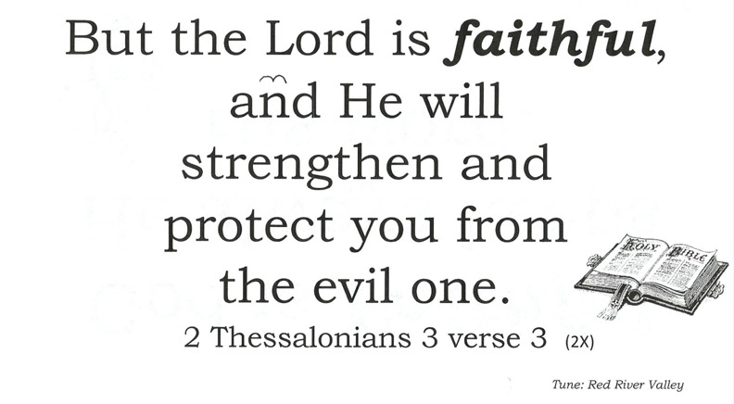
But the Lord is faithful,
and He will
strengthen and
protect you from
the evil one.
2 Thessalonians 3 verse 3
(2X)
Tune: Red River Valley

Slide 17
God is Good
and He takes care of me
(2X)
Tune: Are you sleeping.

Slide 18
Oh, taste and see
that The Lord
is good.
Psalms 34 verse 8a
(3X)
Tune: If You Are Happy and You Know It

Slide 19
God is Gracious
Giving gifts
(2X)
(2X)
Tune: Are you sleeping.

Slide 20
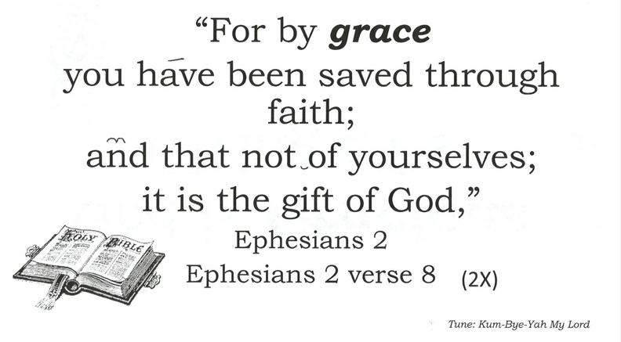
“For by grace
you have been saved through faith;
and that not of yourselves;
it is the gift of God,”
Ephesians 2
Ephesians 2 verse 8
(2X)
Tune: Kum-Bye-Yah My Lord

Slide 21
God is Holy
Sinless, pure
(2X)
(2X)
Tune: Are you sleeping.

Slide 22
“Exalt the LORD our God,
And worship
at His holy hill;
For holy is the LORD
Our God.”
Psalms 99 verse 9
For holy is the LORD our God
Psalms 99 and verse 9
Tune: John Jacob Jingleheimer Schmidt

Slide 23
God is Immutable
Unchanging
(2X)
(2X)
Tune: Are you sleeping.

Slide 24
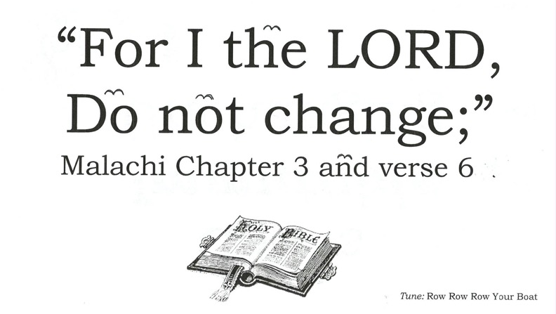
“For I the LORD,
Do not change;”
Malachi Chapter 3 and verse 6a!
Tune: Row Row Row Your Boat

Slide 25
God is Infinite
He cannot
be measured
(2X)
Tune: Are you sleeping.

Slide 26
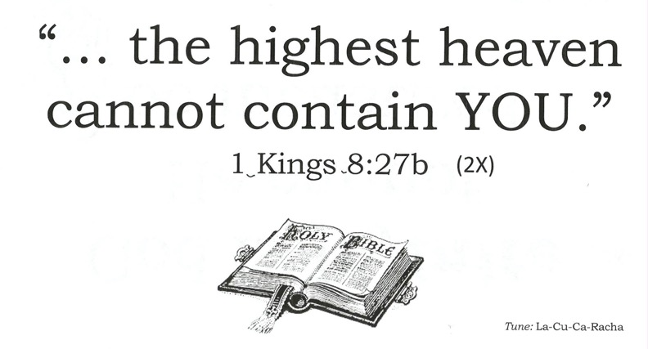
“… the highest heaven
cannot contain YOU.”
1 Kings 8:27b
(2X)
Tune: La-Cu-Ca-Racha

Slide 27
God is Just
Punishing sin
(2X)
Tune: Are you sleeping.

Slide 28
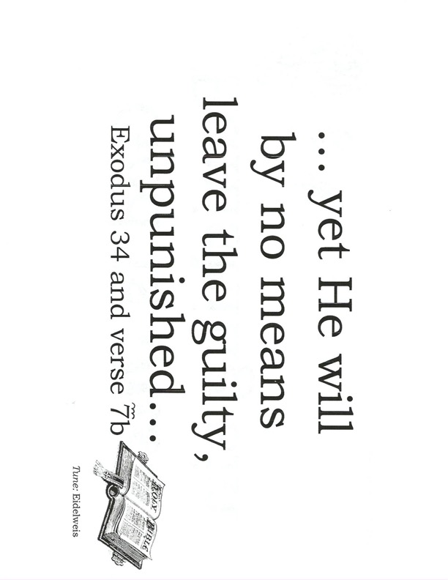
… yet He will
by no means
leave the guilty, unpunished…
Exodus 34 and verse 7b
Tune: Eidelweis

Slide 29
God is Kind
and His kindness never ends
(2X)
Tune: Are you sleeping.

Slide 30
“… for He Himself is kind to everyone.”
Luke Chapter 6 and Verse 35c
Tune: For He’s The Jolly Good Fellow

Slide 31
God is LOVE
so He sent
Lord Jesus
(2X)
Tune: Are you sleeping.

Slide 32
“God is love …”
1 John 4:16b
(2x)
Tune: Are You Sleeping

Slide 33
God’s Longsuffering
He’s patient
(2X)
(2X)
Tune: Are you sleeping.

Slide 34
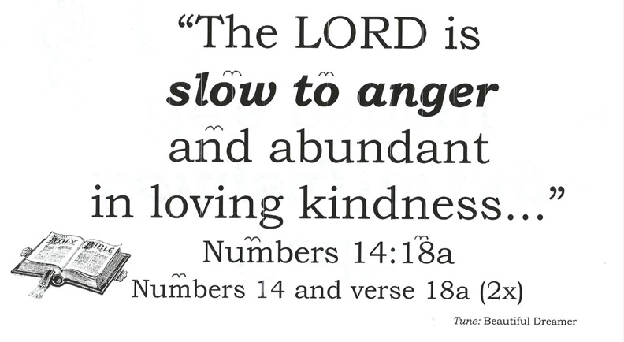
“The LORD is
slow to anger
and abundant
in loving kindness...”
Numbers 14:18a
Numbers 14 and verse 18a (2x)
Tune: Beautiful Dreamer

Slide 35
God is Merciful
He holds back
punishment
(2X)
Tune: Are you sleeping.

Slide 36
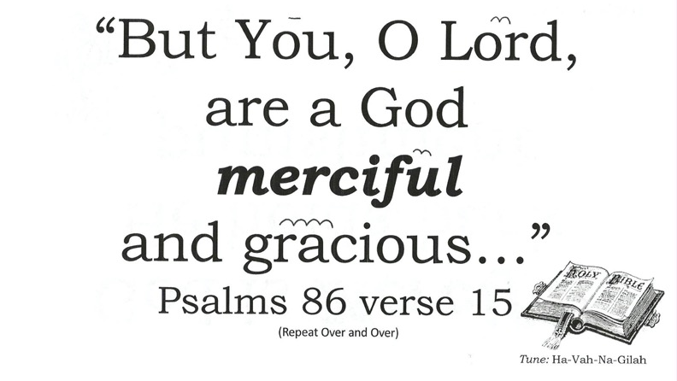
“But You, O Lord,
are a God
merciful
and gracious…”
Psalms 86 verse 15
(Repeat Over and Over)
Tune: Ha-Vah-Na-Gilah

Slide 37
God is Near
to all who
call upon Him
(2X)
Tune: Are you sleeping.

Slide 38
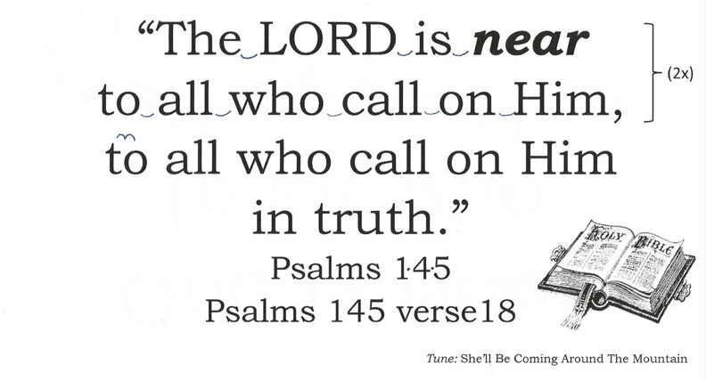
“The LORD is near
to all who call on Him,
to all who call on Him
in truth.”
Psalms 145
Psalms 145 verse18
(2x)
Tune: She’ll Be Coming Around The Mountain

Slide 39
God’s Omnipotent
He is all
powerful
(2X)
Tune: Are you sleeping.

Slide 40
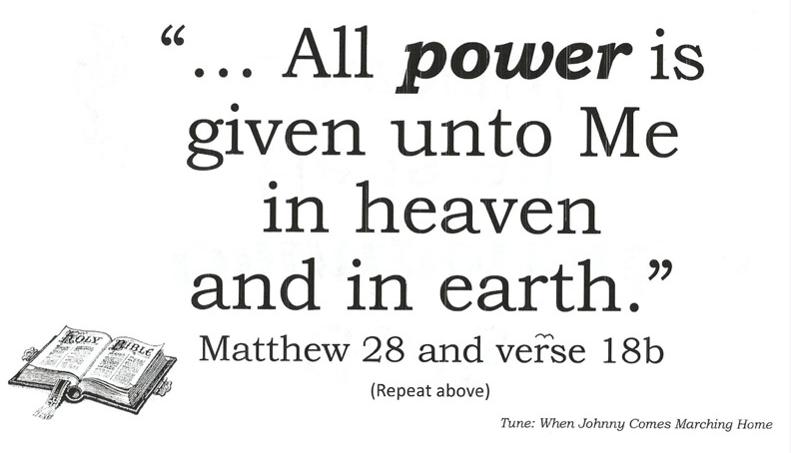
“… All power is
given unto Me
in heaven
and in earth.”
Matthew 28 and verse 18b
(Repeat above)
Tune: When Johnny Comes Marching Home

Slide 41
God’s Omniscient
All knowing
(2X)
(2X)
Tune: Are you sleeping.

Slide 42
“Great is our Lord,
And abundant in strength;
His understanding
Is infinite.”
Psalms 147 verse 5…
(2X)
Tune: London Bridge is Falling Down

Slide 43
God’s Omnipresent
Everywhere
(2X)
(2X)
Tune: Are you sleeping.

Slide 44
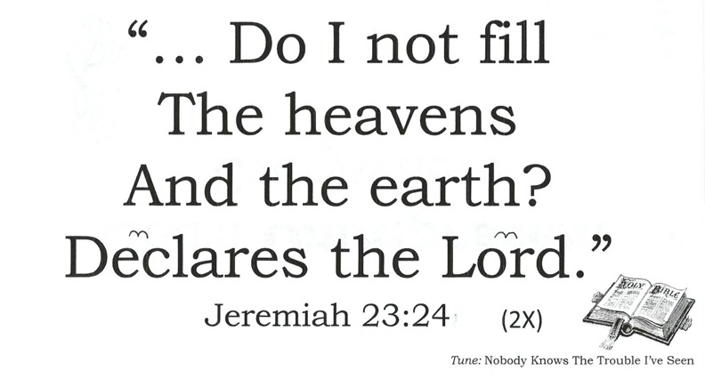
“… Do I not fill
The heavens
And the earth?
Declares the Lord.”
Jeremiah 23:24b
(2X)
Tune: Nobody Knows The Trouble I’ve Seen

Slide 45
God is Peace
and He gives us
His peace
(2X)
Tune: Are you sleeping.

Slide 46
“Peace I leave
with you,
My peace I give
to you;”
John 14:27a
(3X)
Tune: Battle Hymn of the Republic

Slide 47
God is Quick
He’s not slow
about His word
(2X)
(2X)
Tune: Are you sleeping.

Slide 48
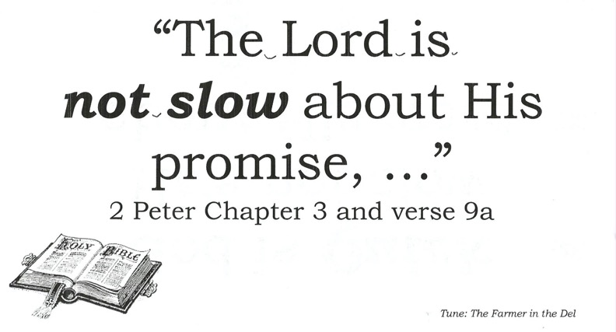
“The Lord is
not slow about His
promise, …”
2 Peter Chapter 3 and verse 9a
Tune: The Farmer in the Del

Slide 49
God is Quiet
And He Speaks in His stillness
(2X)
Tune: Are you sleeping.

Slide 50
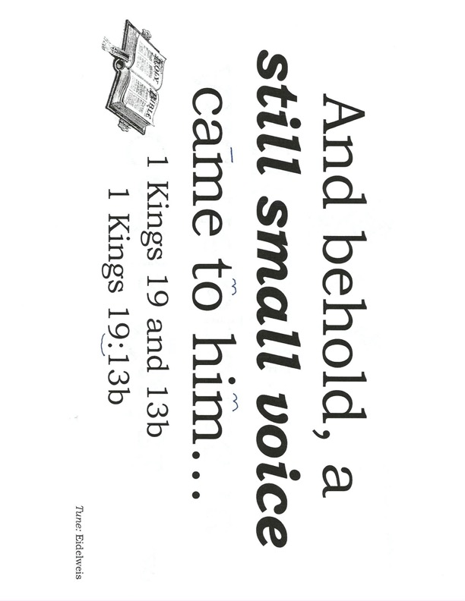
And behold, a still small voice came to him…
1 Kings 19 and 13b
1 Kings 19:13b
Tune: Eidelweis

Slide 51
God is
Righteous
And He gives
His righteousness
(2X)
Tune: Are you sleeping.

Slide 52
“Gracious is the LORD, and righteous…”
Psalms 116:5a
Righteous is the LORD!
Tune: Row-Row-Row Your Boat

Slide 53
God is Sovereign
He controls
everything
(2X)
Tune: Are you sleeping.

Slide 54
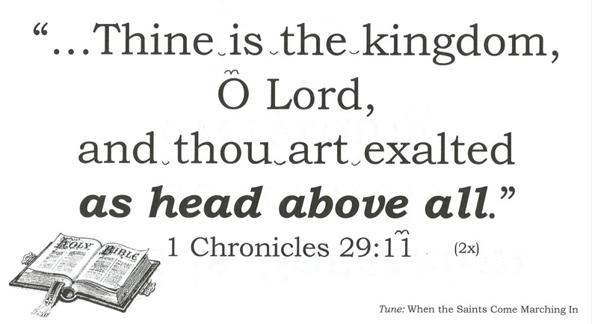
“…Thine is the kingdom,
O Lord,
and thou art exalted
as head above all.”
1 Chronicles 29:11c
(2x)
Tune: When the Saints Come Marching In

Slide 55
God is Truth
what He says
will happen
(2X)
Tune: Are you sleeping.

Slide 56
“Your word
is truth.”
John 17 verse 17b
(2X)
(repeat from beginning)
Tune: When the Saints Go Marching In

Slide 57
God is Triune
Father, Son,
Holy Spirit
(2X)
Tune: Are you sleeping.

Slide 58
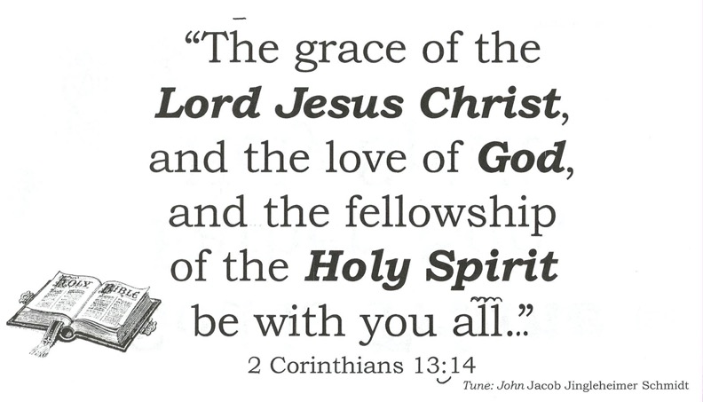
“The grace of the
Lord Jesus Christ,
and the love of God,
and the fellowship
of the Holy Spirit
be with you all.”
2 Corinthians 13:14
Tune: John Jacob Jingleheimer Schmidt

Slide 59
God Understands
He understands
everything
(2X)
Tune: Are you sleeping.

Slide 60
“God understands
the way thereof,
and He knows its place.”
Job 28:23
Job 28:23
God Understands the Way of Things
Tune: She’ll Be Coming Around The Mountain

Slide 61
God is Victorious
and by faith
we have
His victory
(2X)
Tune: Are you sleeping.

Slide 62
“For whatever is
born of God
overcomes the world.
And this is the victory
that has overcome
the world, our faith.”
1 John 5 verse 4
Tune: Row Row Your Boat

Slide 63
God is Wise
and He knows
the best way
(2X)
Tune: Are you sleeping.

Slide 64
“… Let the name
of God be blessed
forever and ever,
for wisdom and power
belong to him.”
Daniel 2 verse 20
(Chant)
Tune: Yankee Doodle

Slide 65
God X-ceeds
He exceeds in
All things
(2X)
Tune: Are you sleeping.

Slide 66
“Now to Him who is able to
do eXceeding abundantly
above all that we ask or think,
according to the power that
worketh in us, unto
Him be glory…” glory, glory
Ephesians 3:20,21a
(repeat)
Tune: John Jacob Jingleheimer Schmidt

Slide 67
God is YHWH
(YAWEH)
He is the
Great I AM
(2X)
Tune: Are you sleeping.

Slide 68
“And God said
to Moses,
I AM WHO I AM.”
Exodus 3:14a
(3X)
Tune: Battle Hymn of the Republic

Slide 69
God is Zealous
and He wants us
to repent
(2X)
Tune: Are you sleeping.

Slide 70
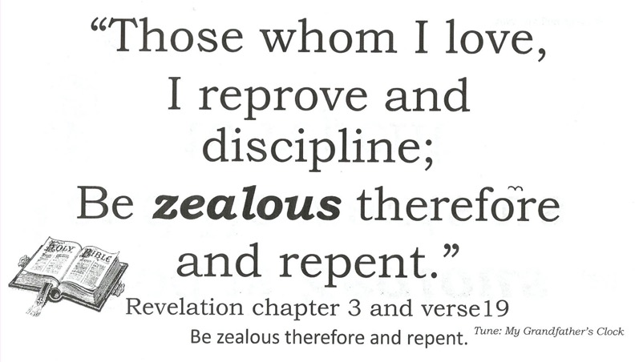
“Those whom I love,
I reprove and discipline;
Be zealous therefore
and repent.”
Revelation chapter 3 and verse19
Be zealous therefore and repent.
Tune: My Grandfather’s Clock

